Slide 1
10.08 Meeting - 2
吳定洋
1

Slide 2

Table of contents
01
02
Wi-Fi RTT
Wi-Fi CSI related
2

Slide 3

01
Wi-Fi RTT
Some related research and work
3

Slide 4
Related Paper
Paper: Testing and Evaluation of Wi-Fi RTT Ranging Technology for Personal Mobility Applications
Main Contribution:
experimental evaluation of Wi-Fi RTT ranging under various conditions device settings, suggesting optimal setups at certain scenarios
suggests alternative range correction models for removing Wi-Fi RTT biases while explores the use of different mobile devices as initiators
Analyzes and compares the proposed correction models
4

Slide 5
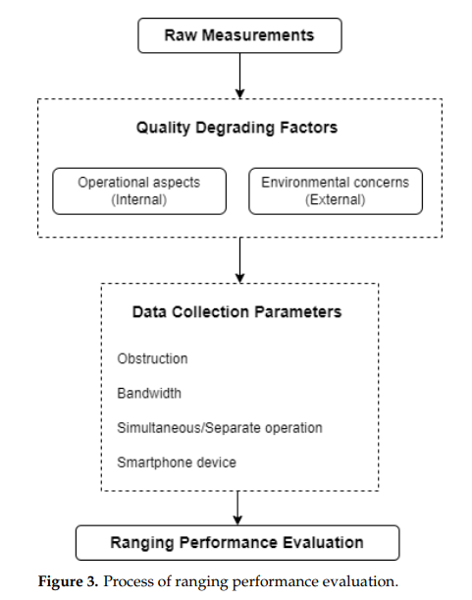
Process of ranging performance evaluation
Internal:
Sample rate, bandwidth, different device
External:
Environment, obstacle, LOS, NLOS, multipath…
Compare these degrading factors and do ranging performance evaluation seperately
5

Slide 6
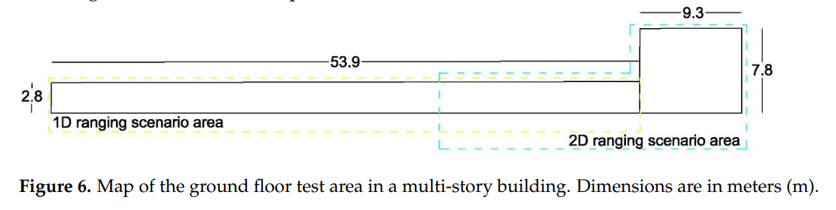
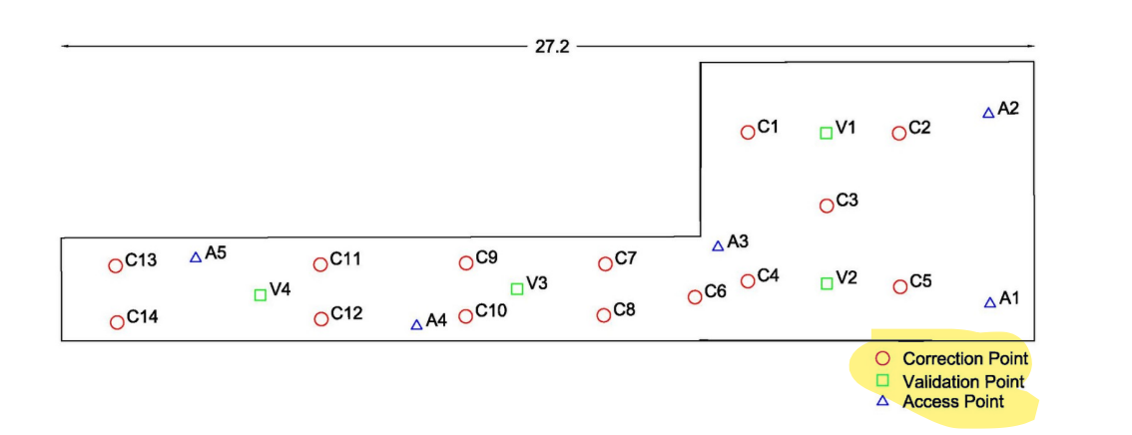
Experimental Environment Setup
6

Slide 7
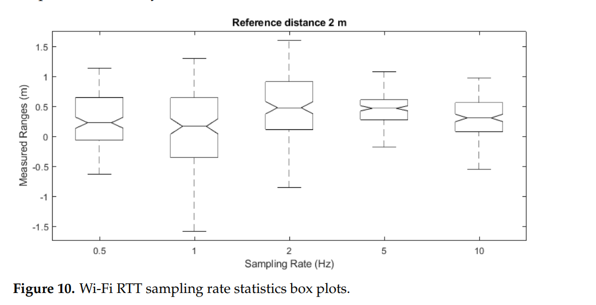
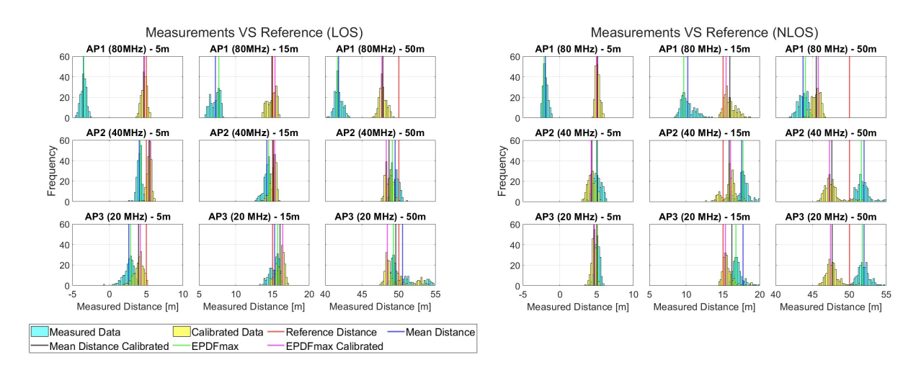
Experiment
7

Slide 8
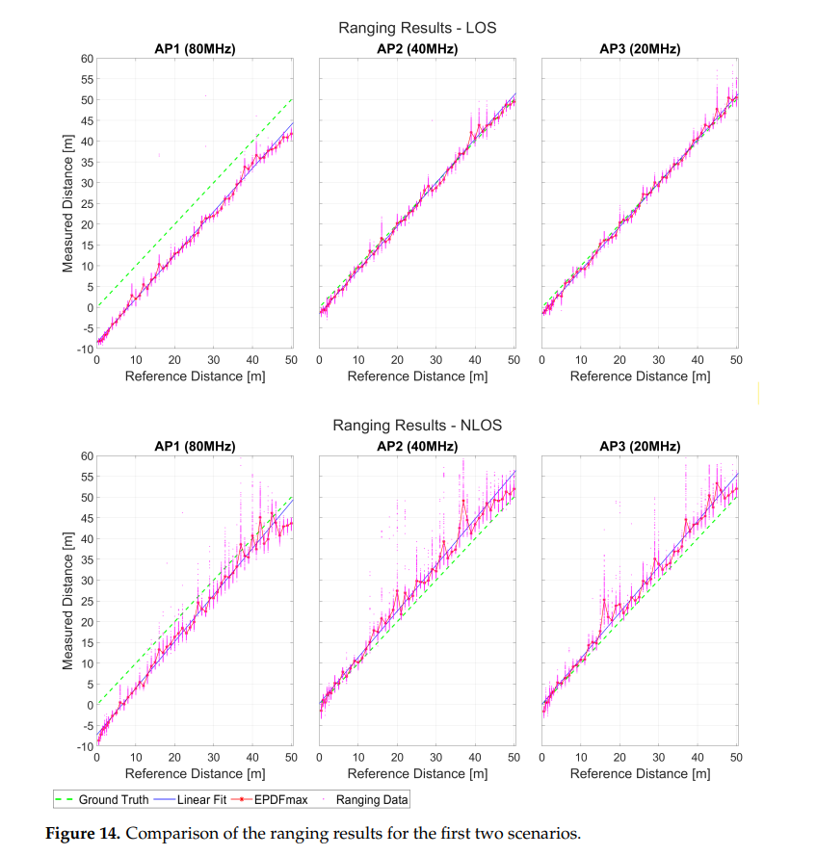
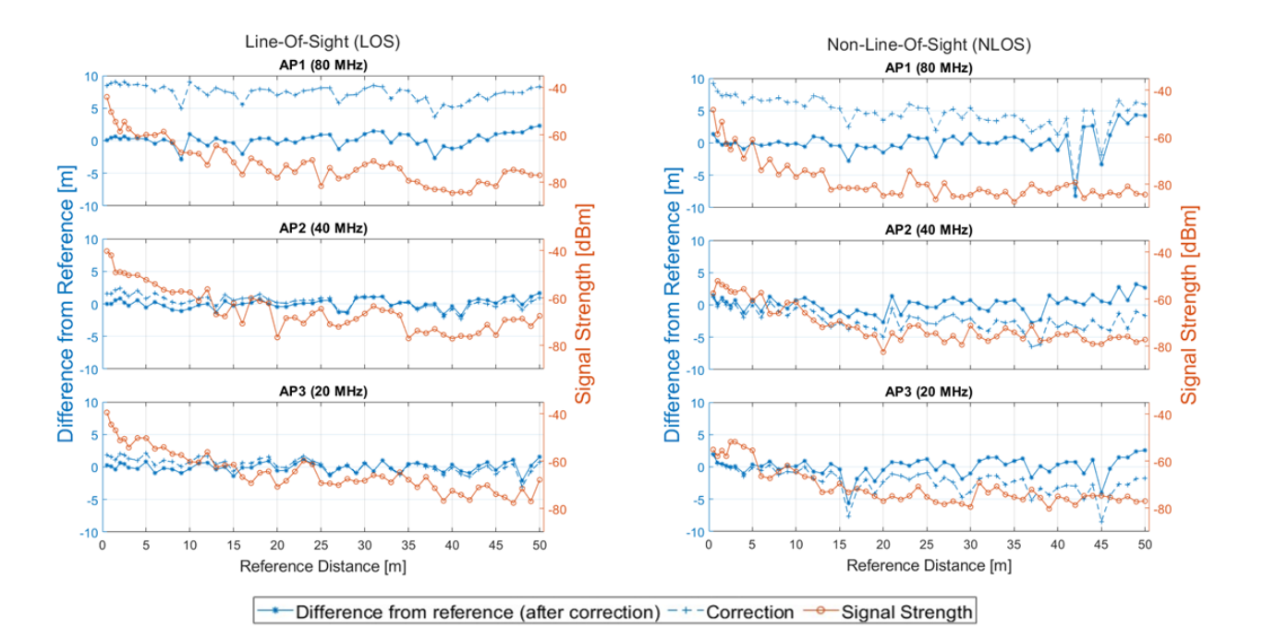
Experiment
8

Slide 9
Reference
Orfanos, M.; Perakis, H.; Gikas, V.; Retscher, G.; Mpimis, T.; Spyropoulou, I.; Papathanasopoulou, V. Testing and Evaluation of Wi-Fi RTT Ranging Technology for Personal Mobility Applications. Sensors 2023, 23, 2829. https://doi.org/10.3390/s23052829
9

Slide 10
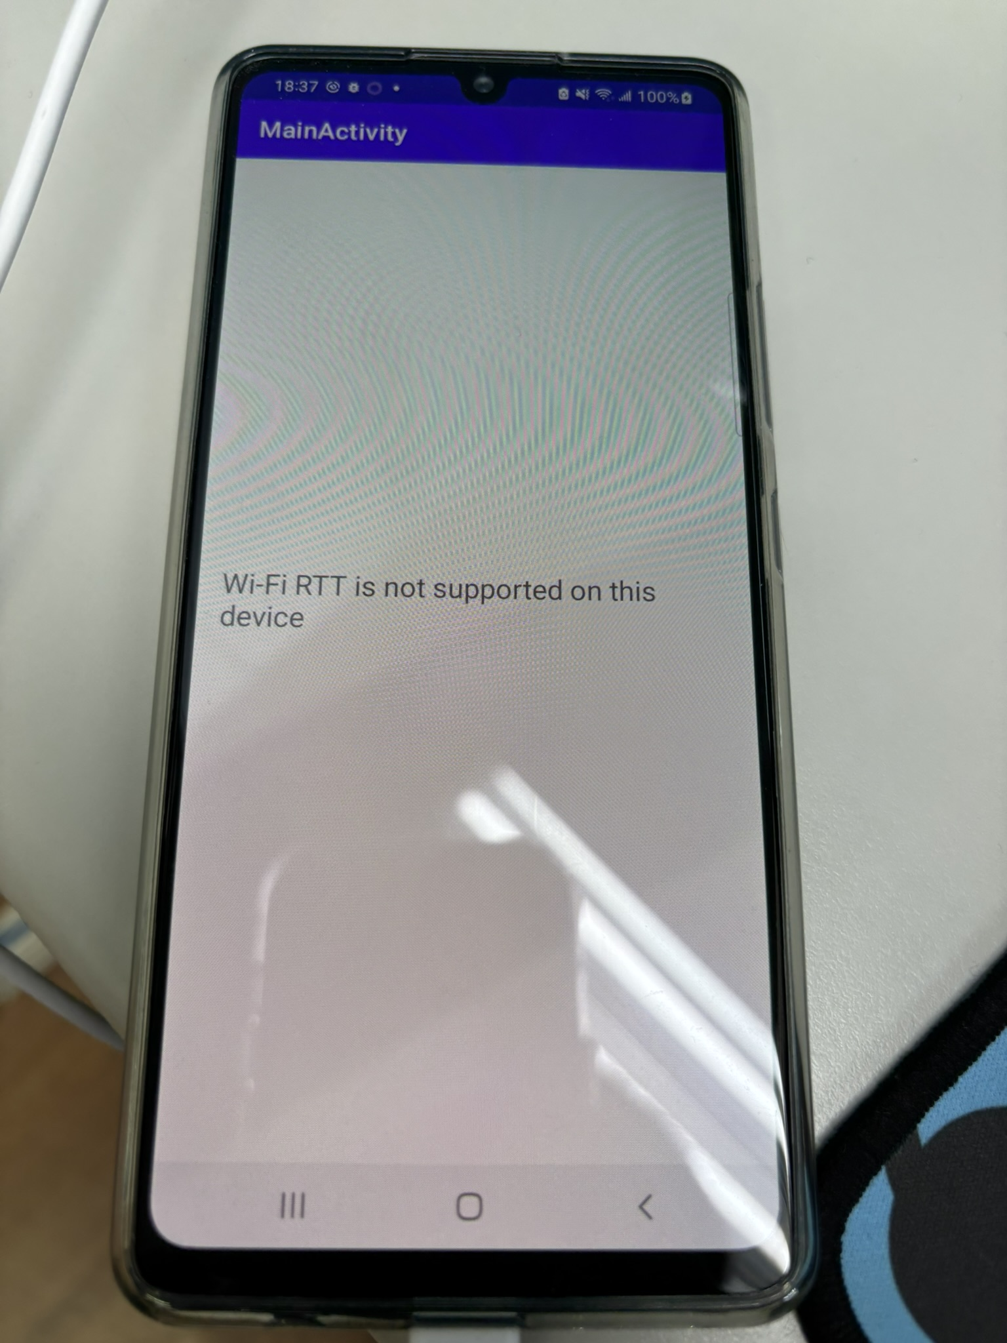
Our RTT rx APP
Unfortunately None of the phones in our lab support WiFi RTT.
10

Slide 11

02
Wi-Fi CSI related
11

Slide 12
Ongoing work
Design an APP that can continuously make traffic to Wi-Fi AP
12

Slide 13

Thanks for Listening!
13

